Slide 1




Engineer #1
KPI #2
Engineer #3
Candidate designs
Engineer #2
Engineer #4
KPI #1

Slide 2




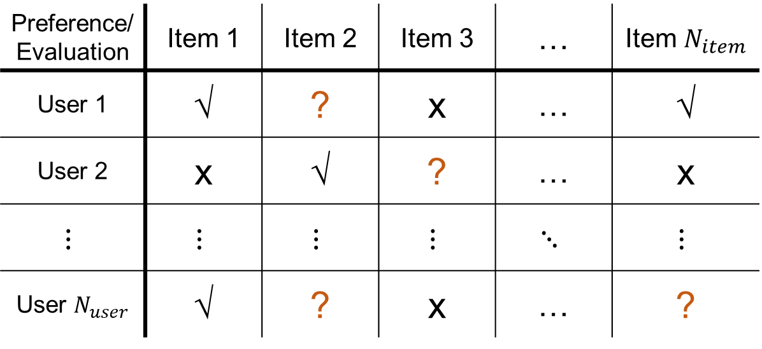
Preference/Evaluation | Item 1 | Item 2 | Item 3 | … | Item $N_{item}$
User 1 | √ | ? | x | … | √
User 2 | x | √ | ? | … | x
$$⋮$$ | $$⋮$$ | $$⋮$$ | $$⋮$$ | $$⋱$$ | $$⋮$$
User $N_{user}$ | √ | ? | x | … | ?

Slide 3







KPI 2
Recommender system
Item $a_{i}$ ?
User $i$
Item $a_{i}$ x
Items
Item $b_{i}$ ?
Item $b_{i}$ √
$$⋮$$
KPI 1

Slide 4




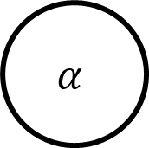

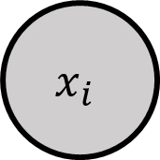
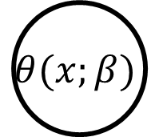
$$β$$
$$θ(x;β)$$
$$α$$
$$GID$$
$$Y(x_{i})$$
$$x_{i}$$
$$N_{item}$$
$$N_{user}$$

